Slide 1

Employee Management System

Slide 2

INTRODUCTION
Employee Management system is an application that enables users to create and store Employee Records.
This application is helpful to department of the organization which maintains data of employees related to an organization .

Slide 3
implement the following features in this project:
Add
VIEW
UPDATE
DELETE
LogIn
SIGNOUT
CONTACT
ABOUT

Slide 4
Tools and technologies used
FULL STACK APPLICATION
Angular CLI
Node JS
Spring Boot Framework
JPA
Hibernate
MySQL

Slide 5
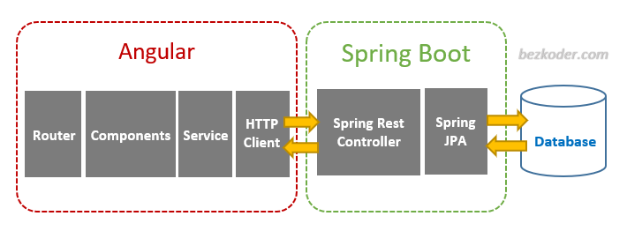
The Architecture of Angular, Spring & database(MySQL)

Slide 6
Angular
Typescript
Frontend-side tools & technologies used
Node JS and NPM
VS Code IDE
Angular CLI
Bootstrap

Slide 7
Spring Boot
Spring Data JPA
Server-side Technologies used
Maven Project
MySQL Database

Slide 8
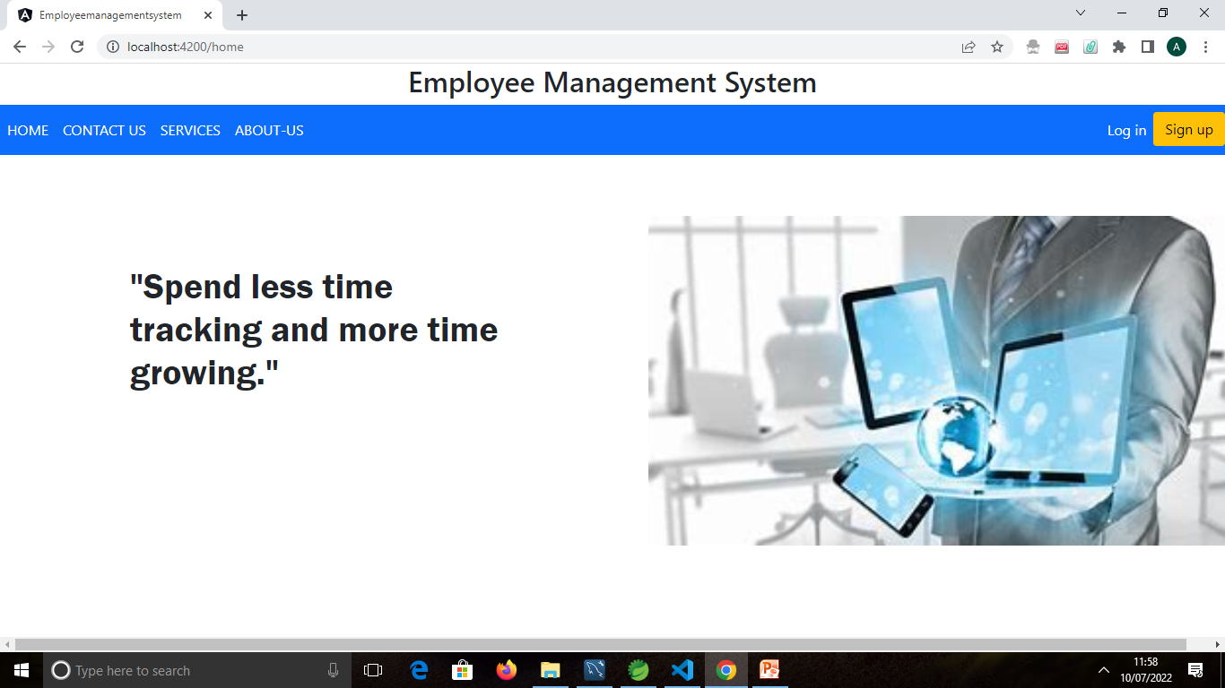
Home Page

Slide 9
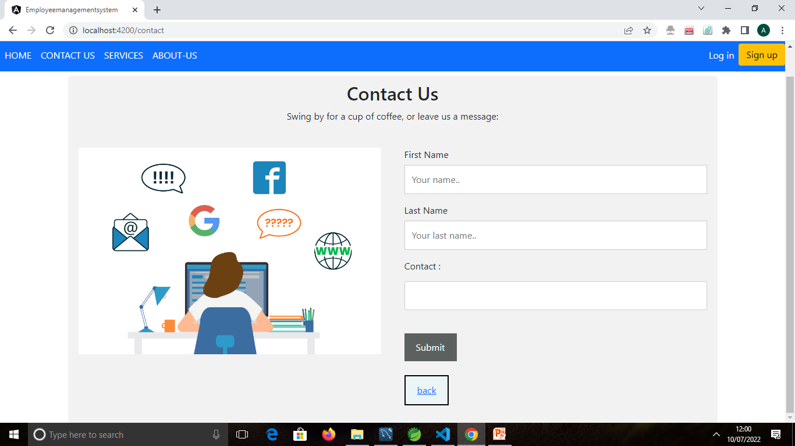
Contact Page

Slide 10
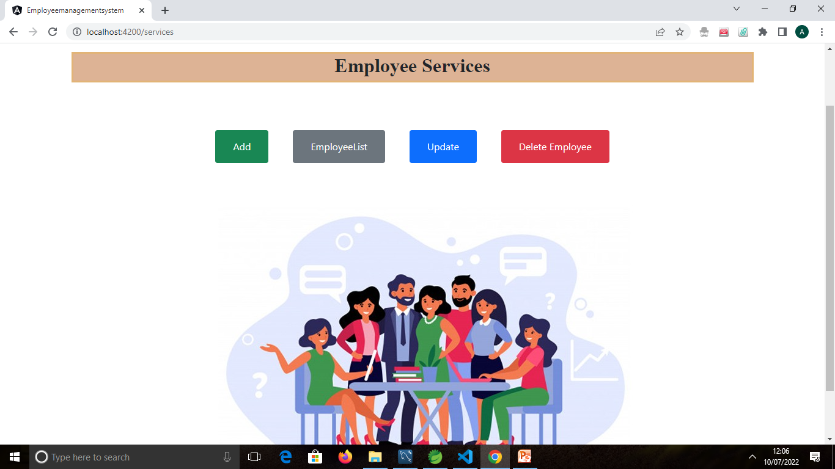
Service Page

Slide 11
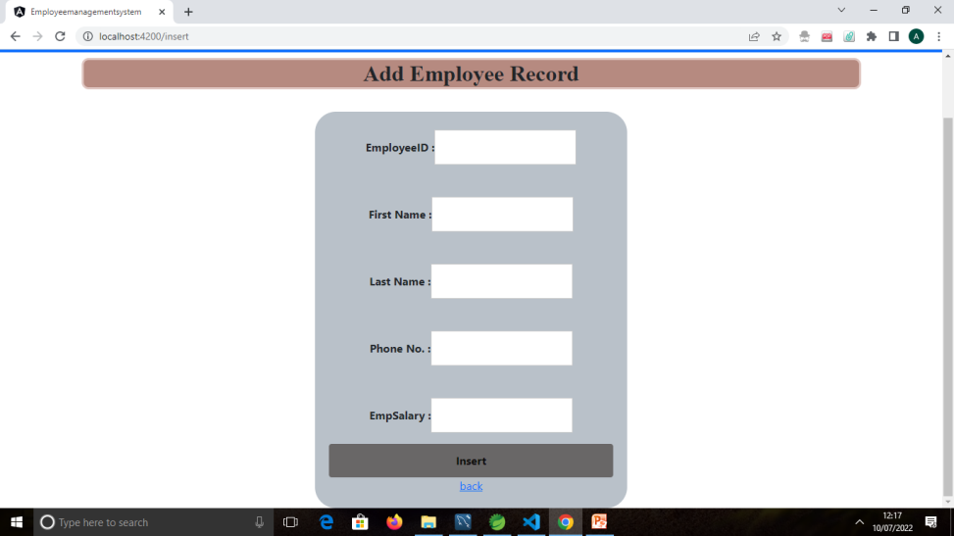
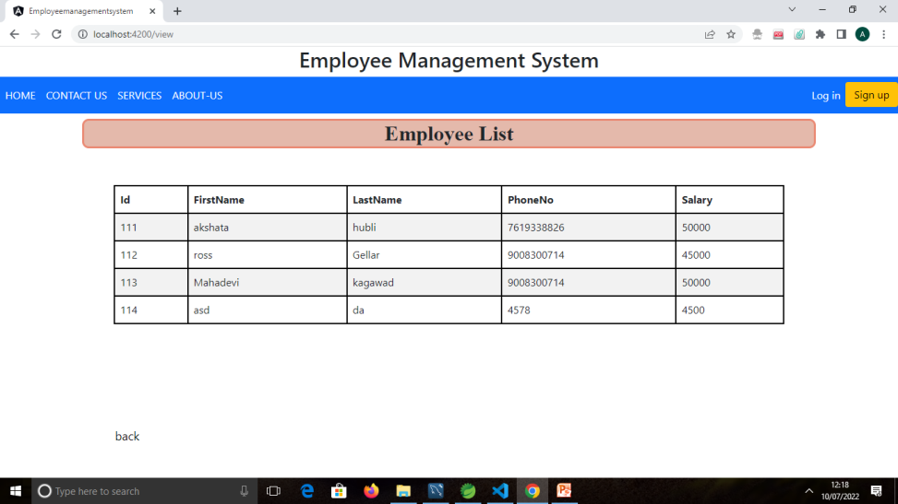
Add and View Pages

Slide 12
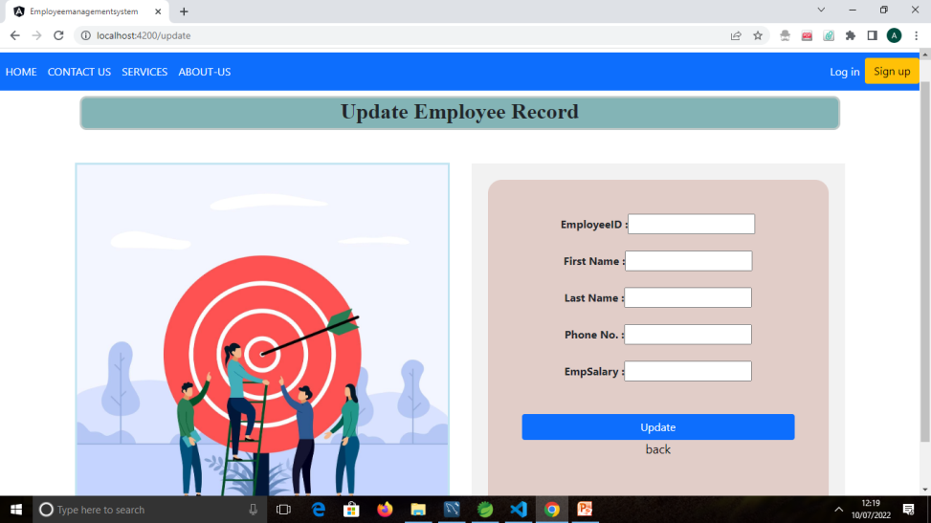
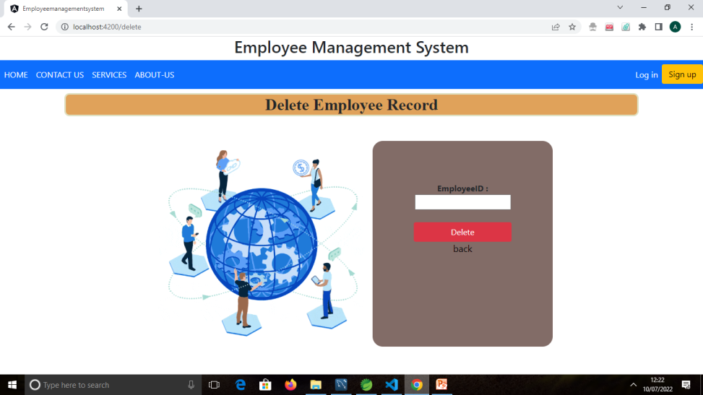
Update and Delete Pages

Slide 13
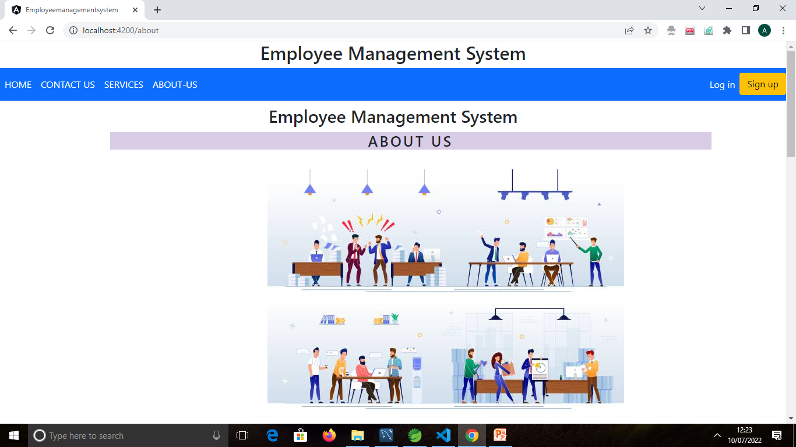
About Us Page

Slide 14
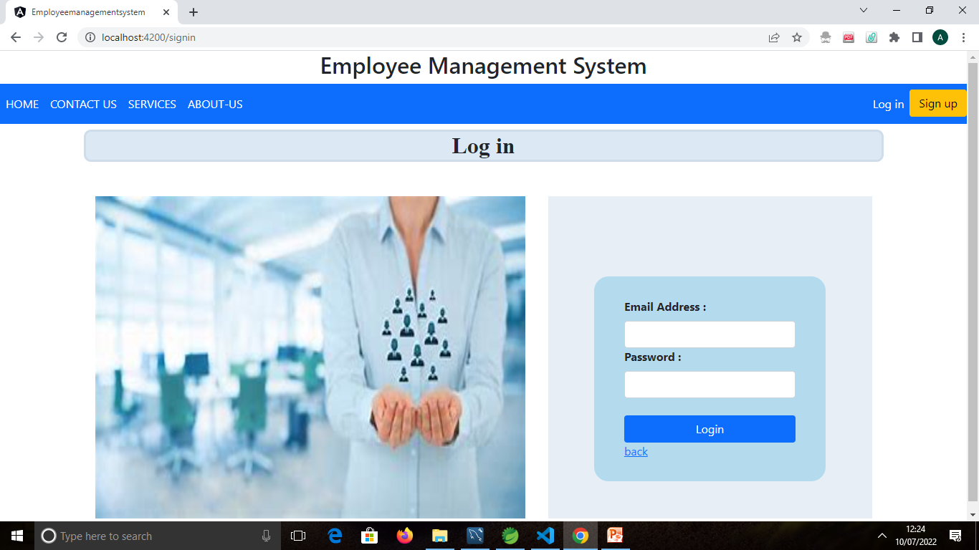
LogIn Page

Slide 15
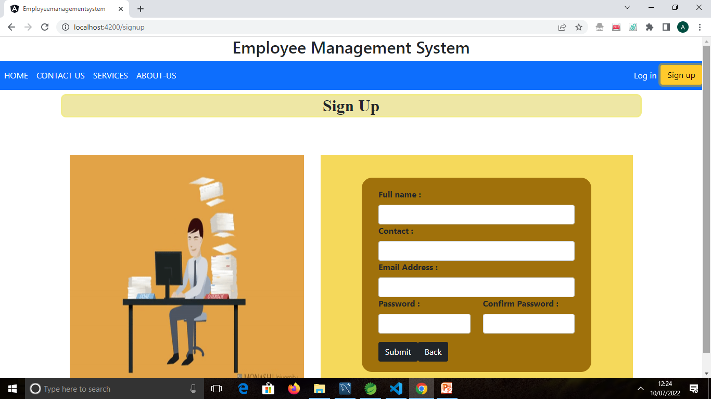
SignUp Page

Slide 16
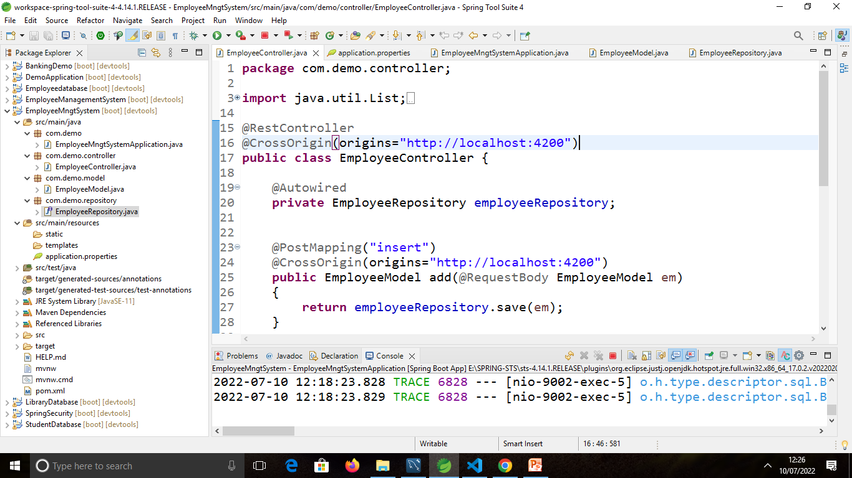
Spring Boot Application

Slide 17
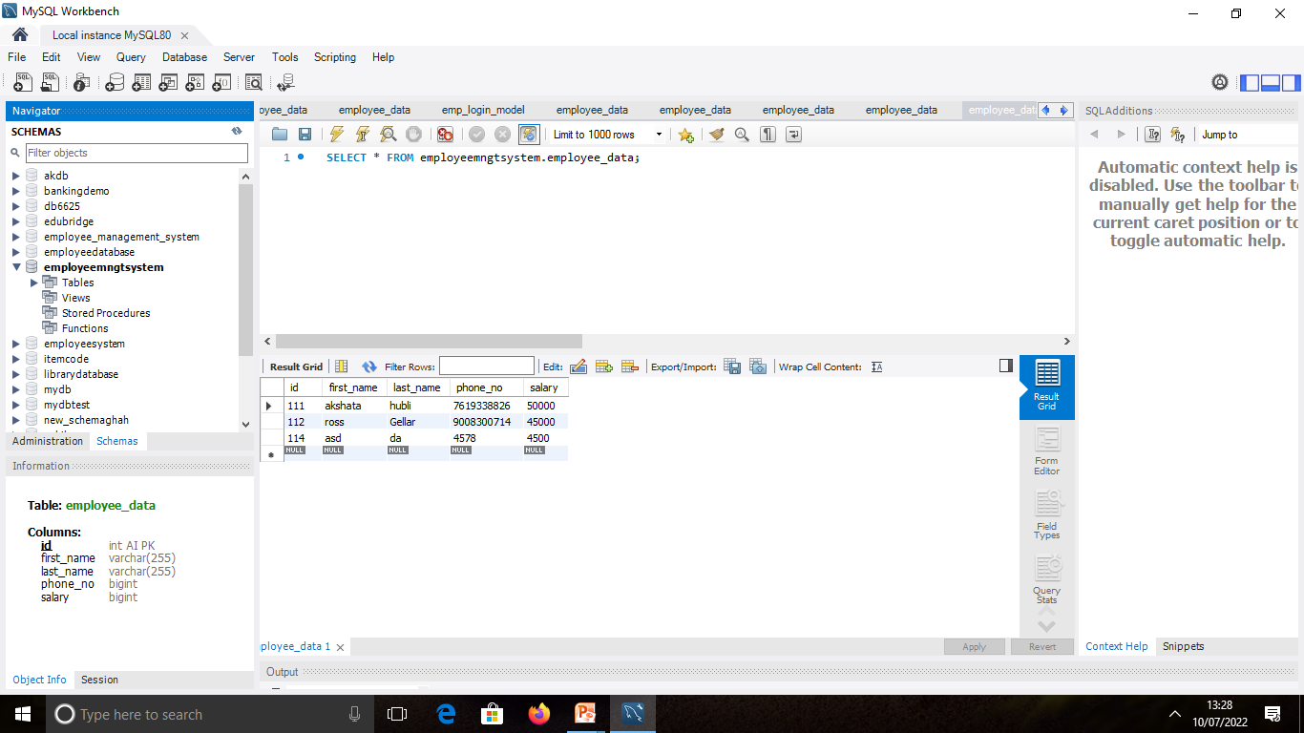
MySQL

Slide 18
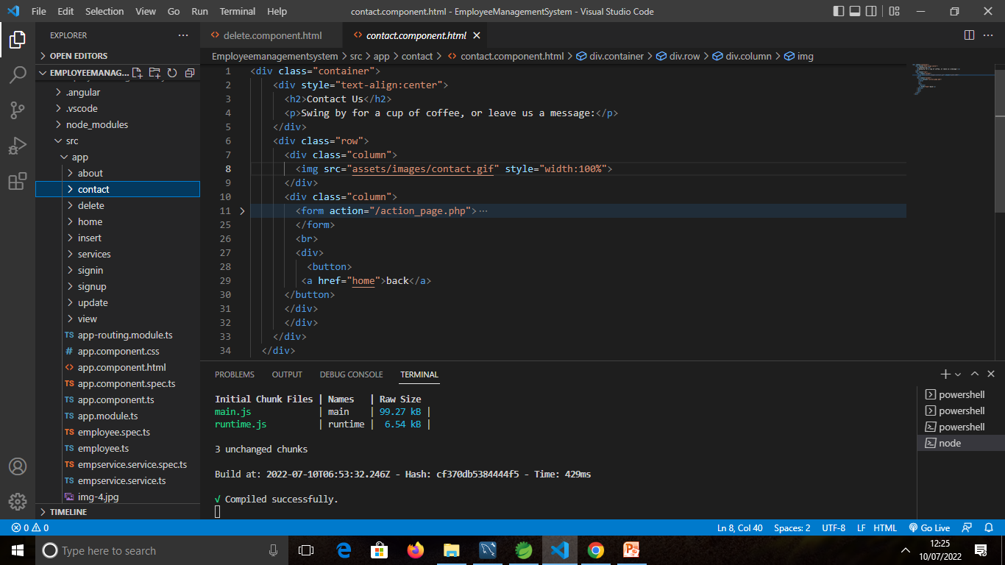
Angular JS

Slide 19
Feature Scope
Employee Management System is a distributed application , developed to maintain the details of employees working in any organization . It the information about the personal details of their employees , also the details about the payroll system which enable to generate the payslip.
Time , Attendance and leave management.
Employee self service.
Performance management.

Slide 20

GitHub Link
https://github.com/Akshata2298/Full-Stack-Project

Slide 21


